Slide 1
Principles of Software Engineering
Ramaswamy Krishnan Chittur

Slide 2
Scope
Software Engineering deals with how to design and develop a reasonably big software – big enough that it warrants multiple phases and multiple developers
Software development lifecycle.
Spec the software requirements.
Model the software using UML diagrams.
Architecting big software. This involves analyzing the following:
The various components that are required.
The dependencies between the components, and how they would communicate with each other.
Make well thought-out design choices (cost-benefit ratio, risks).
Design and design patterns.
Predict the performance.
Implement.
Validate.
Track the progress of the project throughout the development cycle.

Slide 3
Software Development Life Cycle (SDLC)
Systematic process to develop a large software system:
Gathering requirements
Writing specification document
Architecture and Design
Development
Integration
Testing and Validation
Deployment
Maintenance
Common SDLC Models:
Waterfall
Agile
More models some of which are hybrid of these two fundamental SDLC models

Slide 4
Fundamentals of good software
Good software has:
A good design document.
Well designed components.
Safe, clean and well structured code.
Fitting data structures and good algorithms.
Good test matrix.

Slide 5
Coding Guidelines
Programming is the art of writing essays in crystal clear prose and making them executable
Dr. Per Brinch Hansen
Coding standards
Structuring
Function signatures.
Function length.
Formatting
Consistency.
Indentation, whitespace.
Readability and maintainability.
Commenting
Public interfaces and difficult-to-understand steps should be commented.
Don’t be too verbose. Don’t comment the obvious.

Slide 6
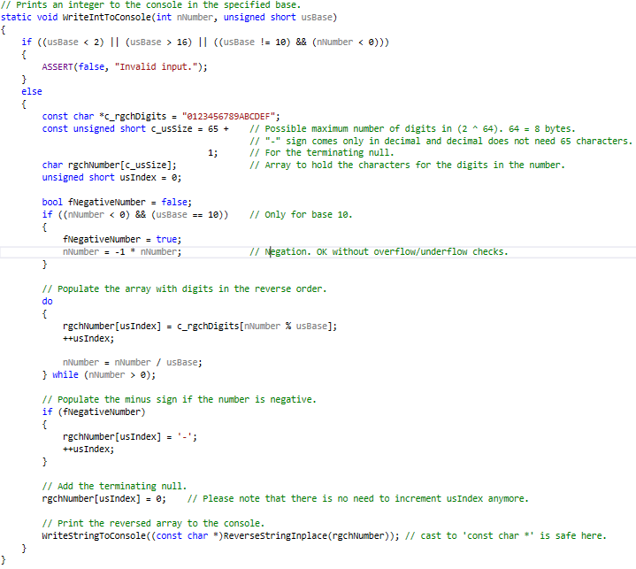
Sample code
Comment the function. (Xml style, more detailed, comment parameters/returns).
Parameter validation.
Comment where required.
Do not comment the obvious.
Empty lines to reduce clutter.
Function signatures. HRESULTs versus Booleans versus voids.
Language features: const and the like.
Conventions: Hungarian notations and the like.
Fits in one page / monitor screen.

Slide 7
Coding Guidelines Revisited
Coding standards
Structuring
Function signatures.
Function length.
Formatting
Consistency.
Indentation, whitespace.
Readability and maintainability.
Commenting
Public interfaces and difficult-to-understand steps should be commented.
Don’t be too verbose. Don’t comment the obvious.

Slide 8
Specification Document (Spec)
Blueprint of the software system being developed.
Typical spec contains:
Requirements
Goals
Architecture and Design, use UMLs to represent ideas
Interfaces, Prototype code
Analysis of performance, security
Validation techniques
Examples:
GitHub - chittur/parallel-programming-language: A new language for parallel programming, and its compiler and runtime
From the course Moodle page here.

Slide 9
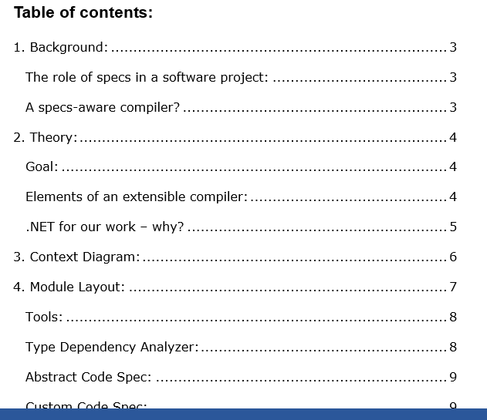
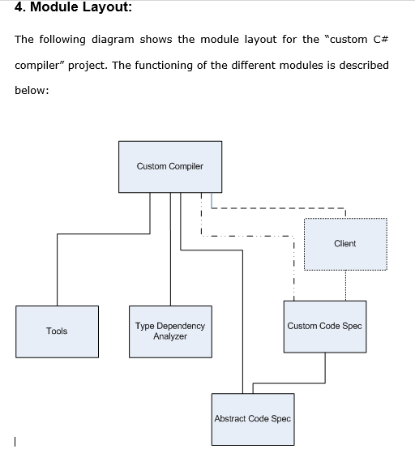
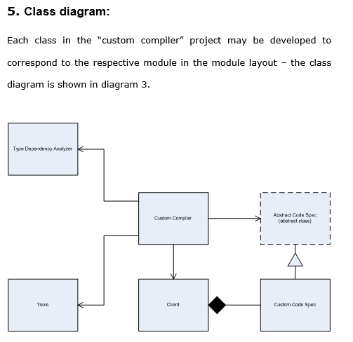
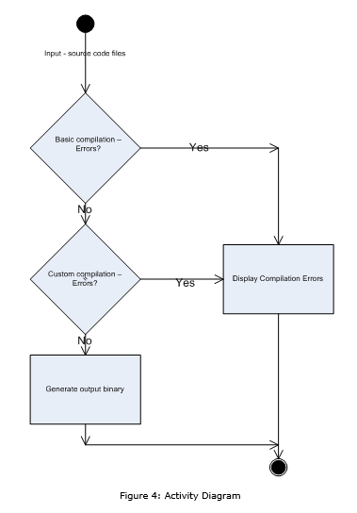
Specs and design docs
“Writing is a rigorous test of simplicity: It is just not possible to write convincingly about ideas that cannot be understood.” –
Dr. Per Brinch Hansen.

Slide 10
Q & A

